Slide 1
Neon Signs
Tim Craddock – FLVT School

Slide 2
Conductors & Insulators
Tim Craddock – FLVT School

Slide 3
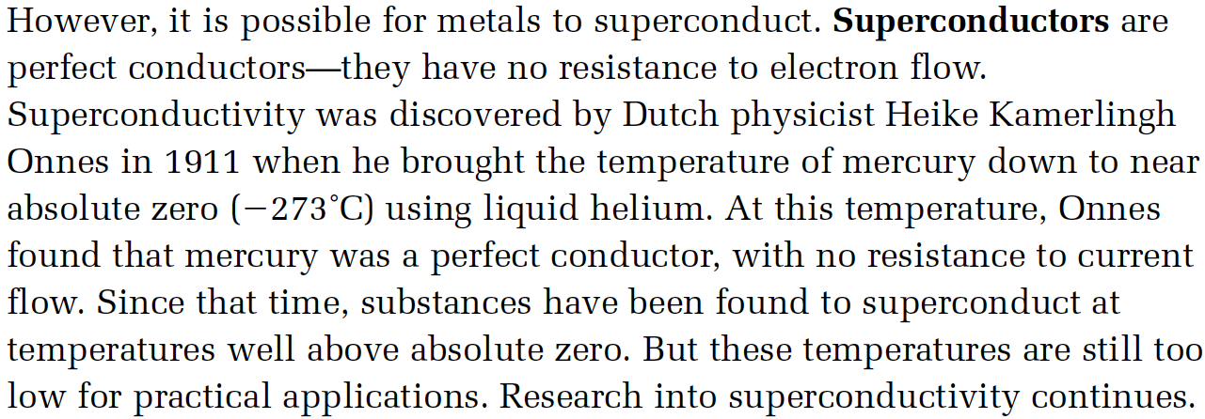
Superconductors
Tim Craddock – FLVT School

Slide 4
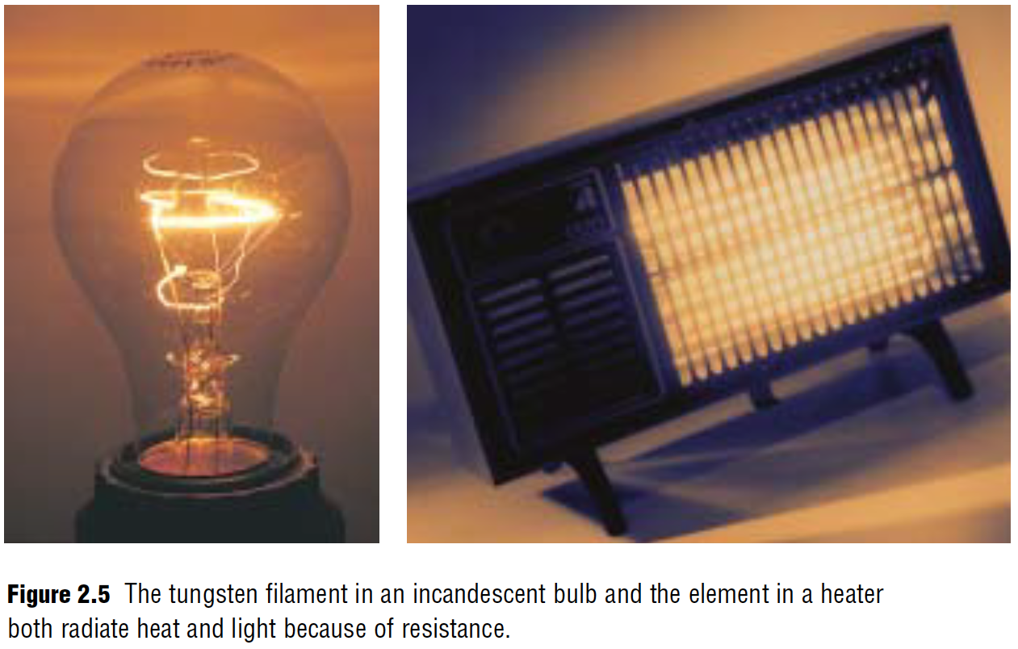
Resistors
Tim Craddock – FLVT School

Slide 5
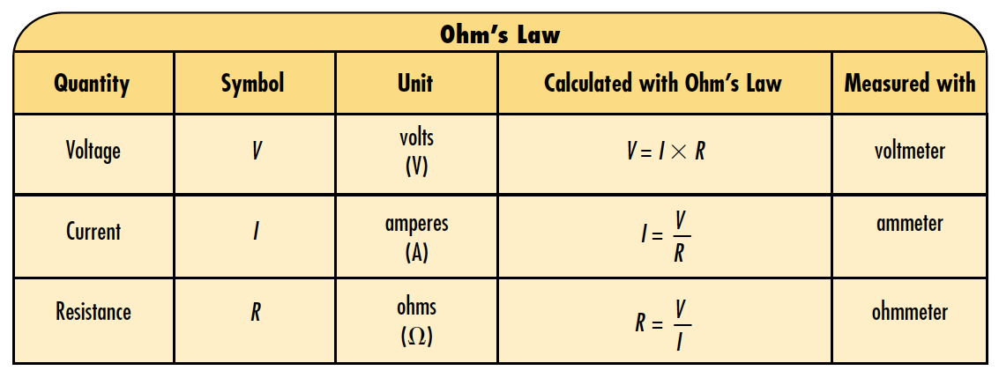
Ohm’s Law
Tim Craddock – FLVT School

Slide 6
Ohm’s Law
Tim Craddock – FLVT School

Slide 7
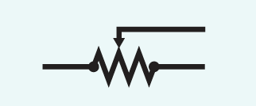
Rheostat (Variable Resistor)
Dimmer Switch
Tim Craddock – FLVT School

Slide 8
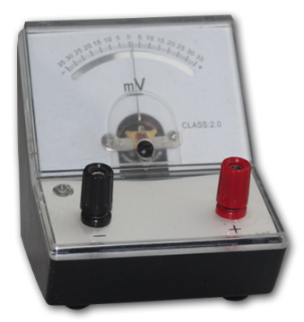
Meters – Voltmeter & Millivoltmeter
Tim Craddock – FLVT School

Slide 9
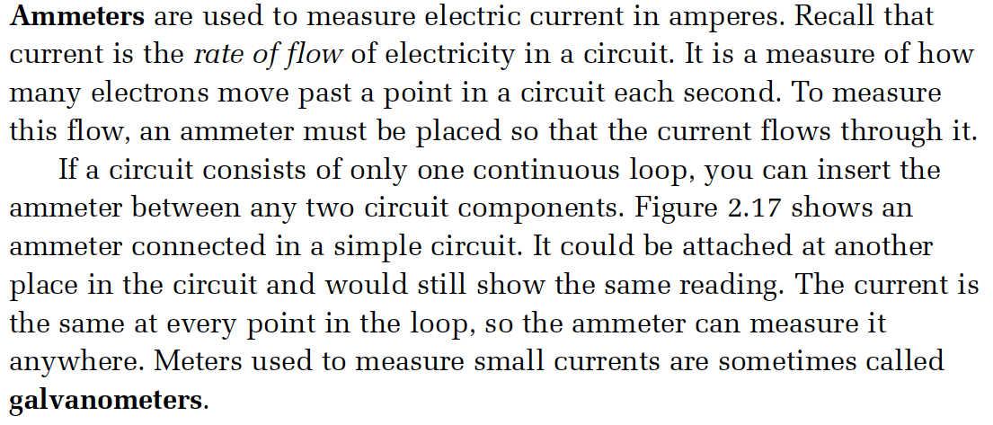
Meters – Ammeter & Galvanometer
Tim Craddock – FLVT School

Slide 10
Multimeters
Tim Craddock – FLVT School

Slide 11
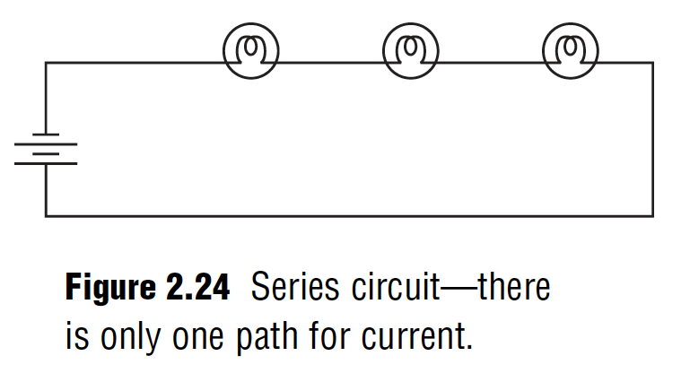
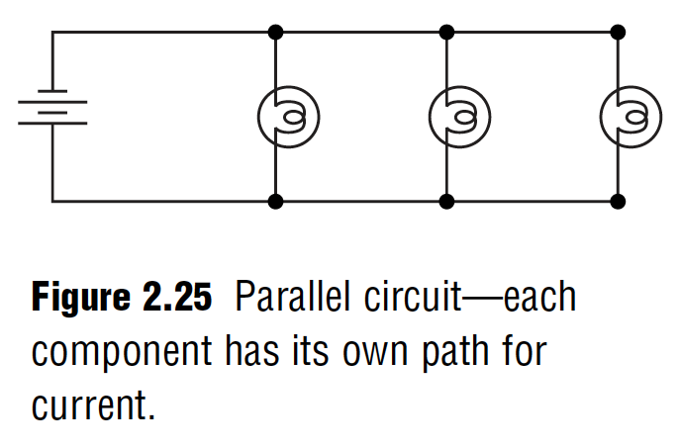
Circuits
Series Circuit
Parallel Circuit
Connected in 1 big loop
Only 1 pathway
If one load breaks and disrupts the flow, the whole circuit shuts down
As more loads are added to the circuit, the loads receive less power as they all share the energy as all the loads are connected to the same circuit (loop).
Connected in a ”ladder”
Many pathways
If one load breaks down, the other loads will not be affected unless they are connected to the same loop in the circuit.
As more loads are added, the other loads are not affected.
Tim Craddock – FLVT School

Slide 12
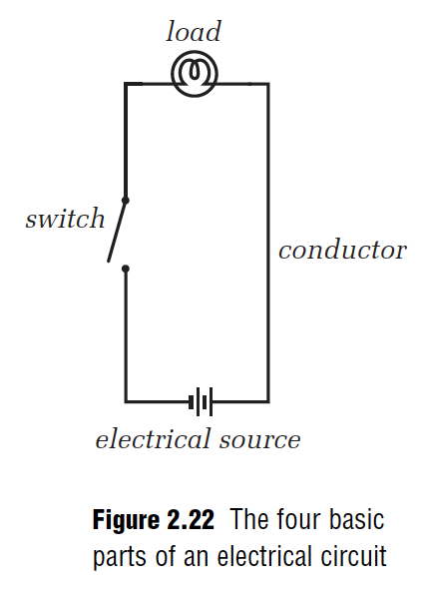
Parts of a Circuit
Tim Craddock – FLVT School

Slide 13
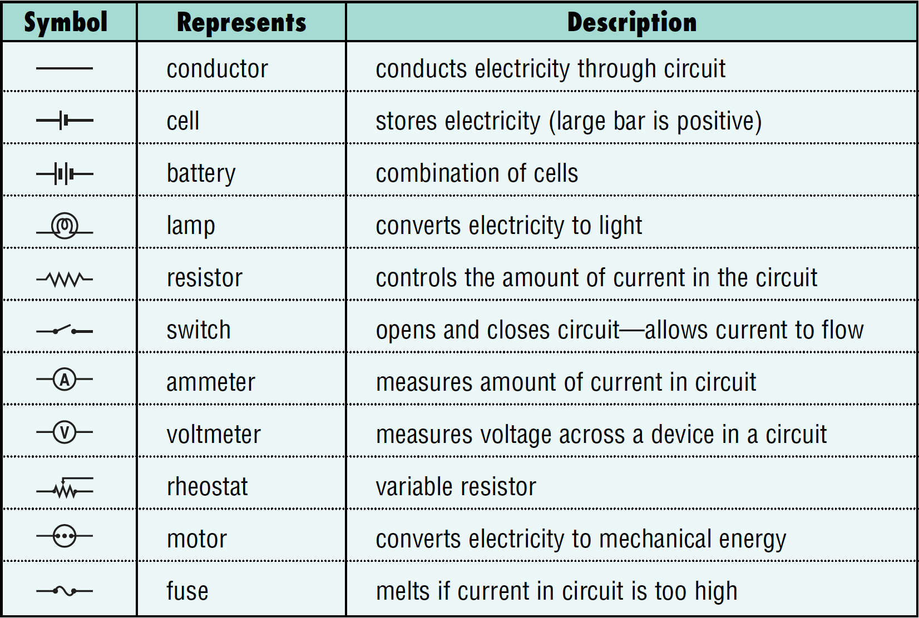
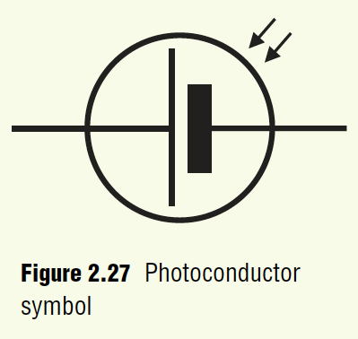
Circuit Symbols
Tim Craddock – FLVT School

Slide 14
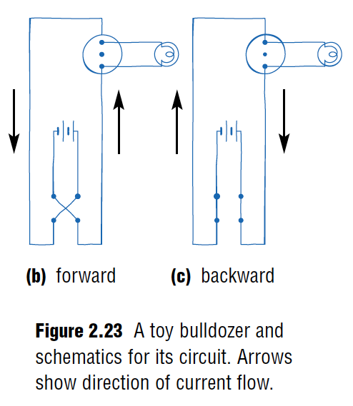
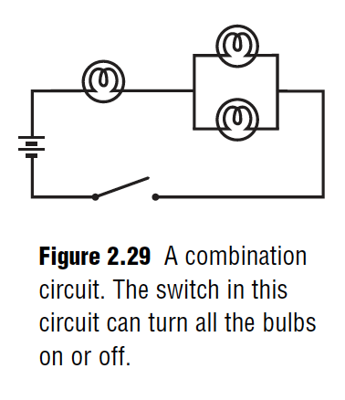
Examples of some circuits
Tim Craddock – FLVT School

Slide 15
Microchips
Tim Craddock – FLVT School

Slide 16
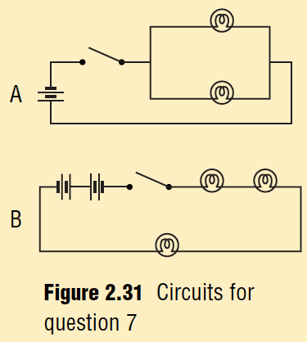
Circuits
Tim Craddock – FLVT School

Slide 17
Circuits
Tim Craddock – FLVT School

Slide 18
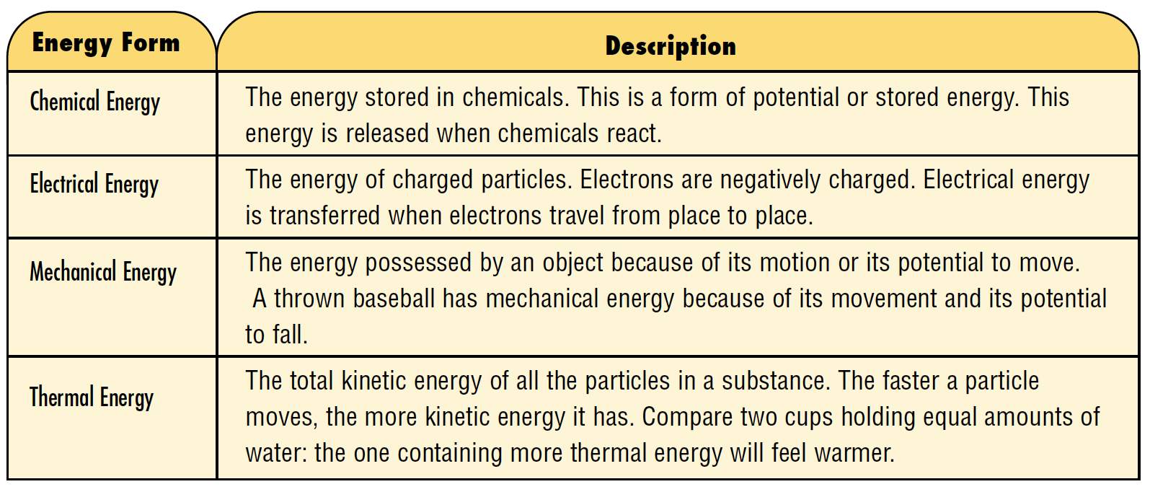
Types of Energy
Tim Craddock – FLVT School

Slide 19
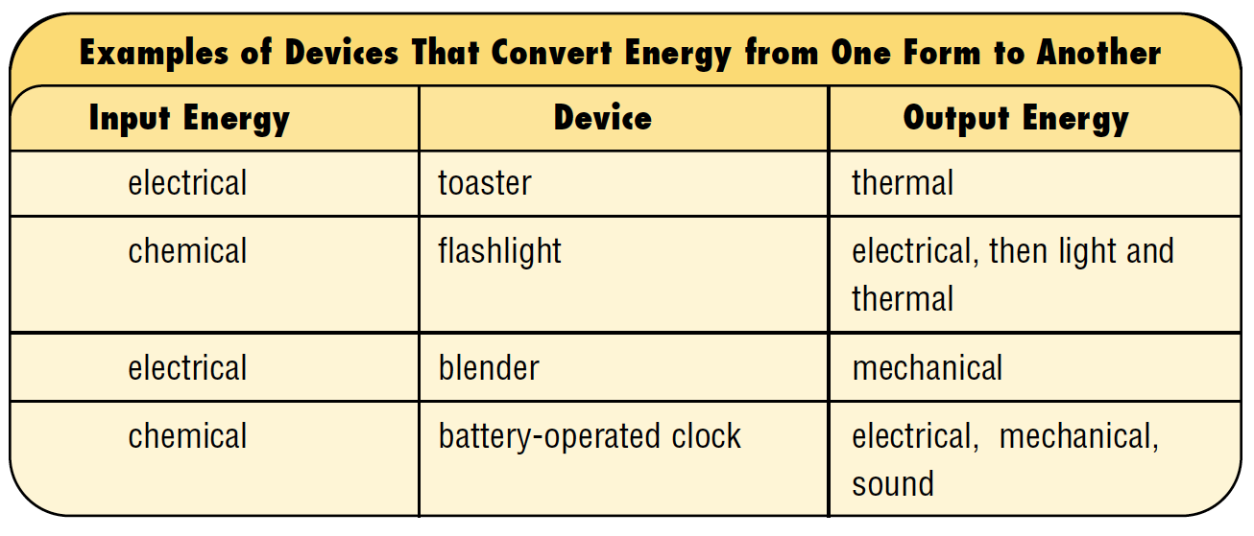
Energy Transformations
Tim Craddock – FLVT School

Slide 20
Thermocouple
Tim Craddock – FLVT School

Slide 21
Direct vs. Alternating Current
Tim Craddock – FLVT School

Slide 22
Transformers
Tim Craddock – FLVT School

Slide 23
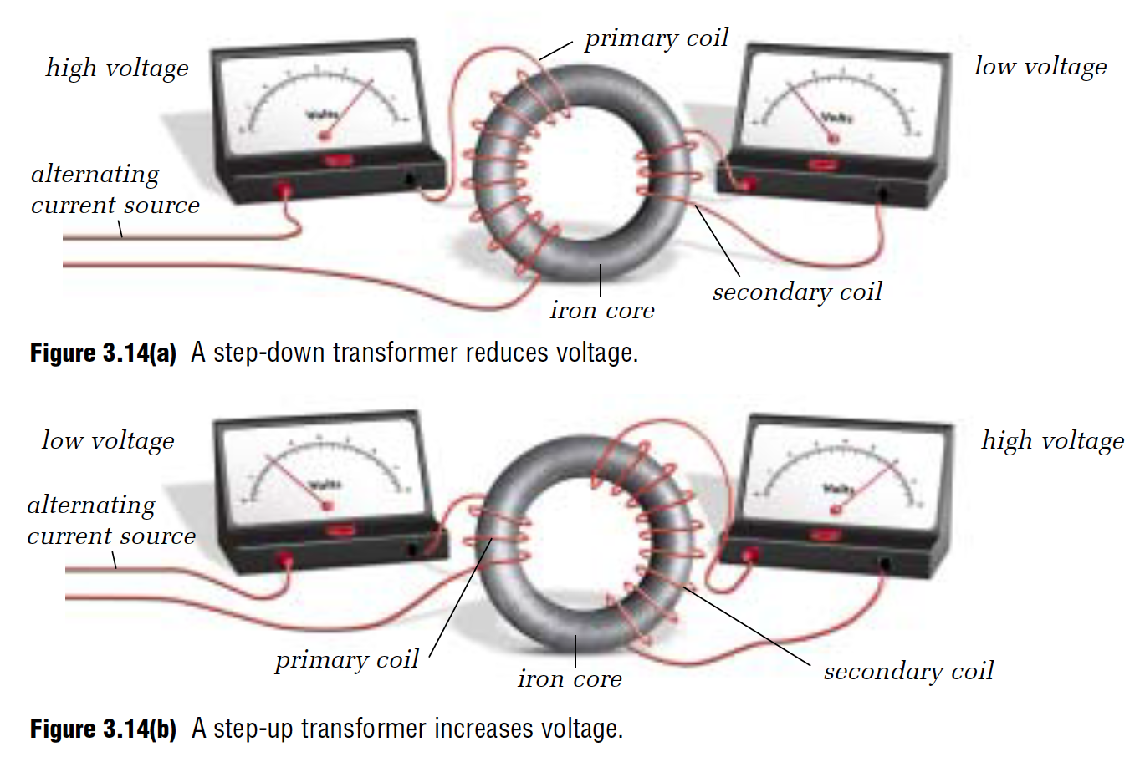
Transformers
Tim Craddock – FLVT School

Slide 24
Power
Tim Craddock – FLVT School

Slide 25
Power
Tim Craddock – FLVT School

Slide 26
Energy
Tim Craddock – FLVT School

Slide 27
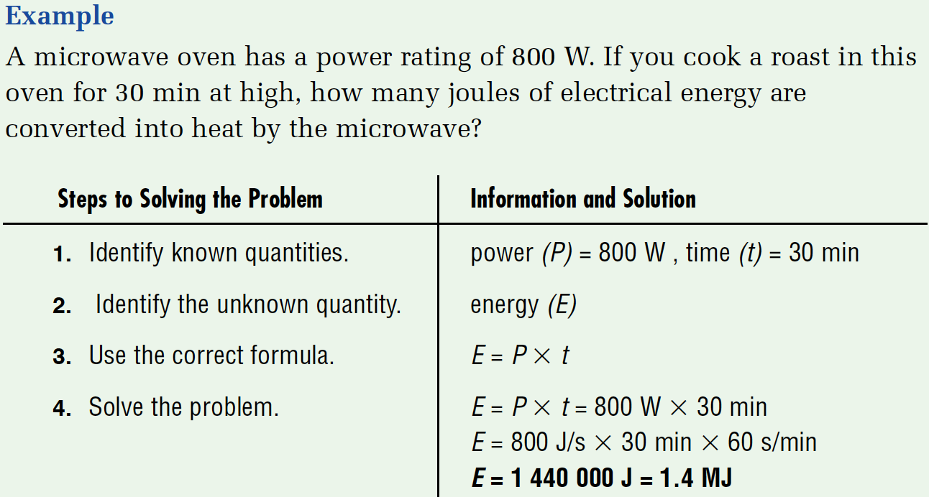
Calculating Energy
Tim Craddock – FLVT School

Slide 28
Energy can also be calculated in kilowatt hours (kW.h)
Tim Craddock – FLVT School

Slide 29
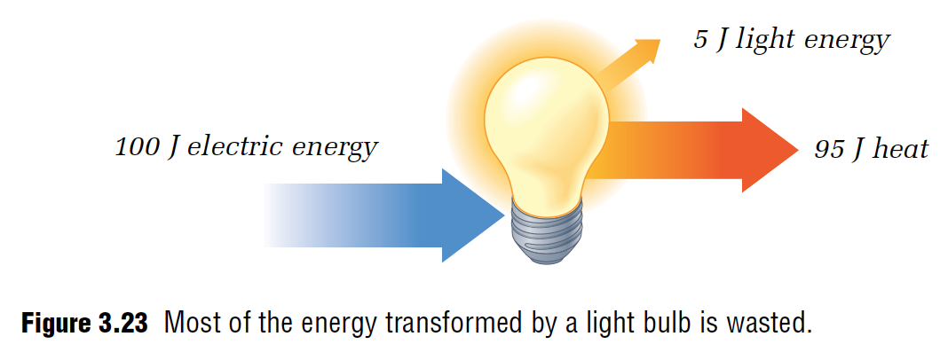
Efficiency
Tim Craddock – FLVT School

Slide 30
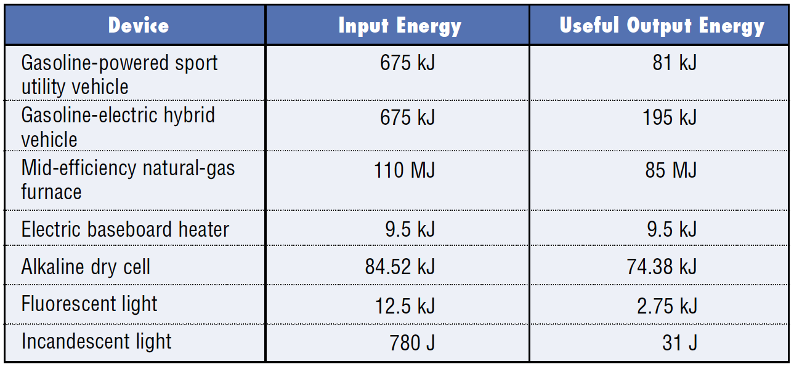
Which device is the most efficient?
Tim Craddock – FLVT School

Slide 31
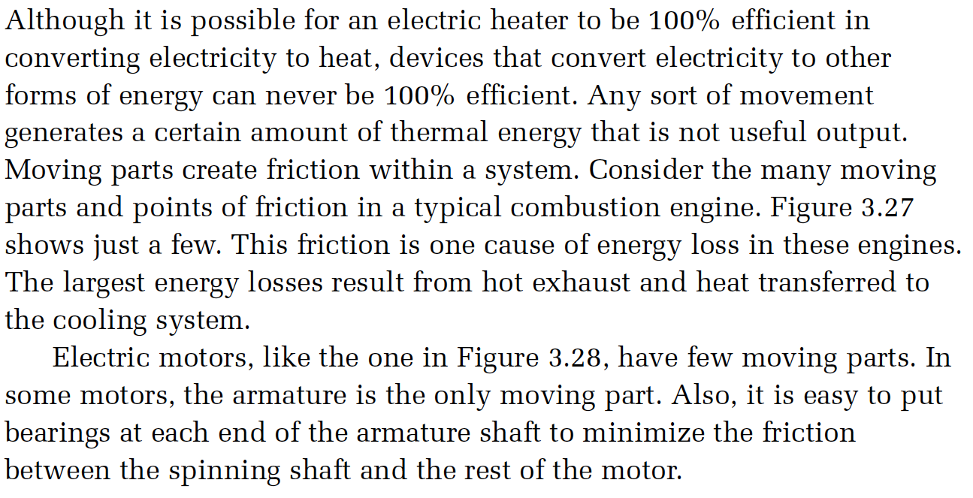
Limits to efficiency!
Tim Craddock – FLVT School

Slide 32
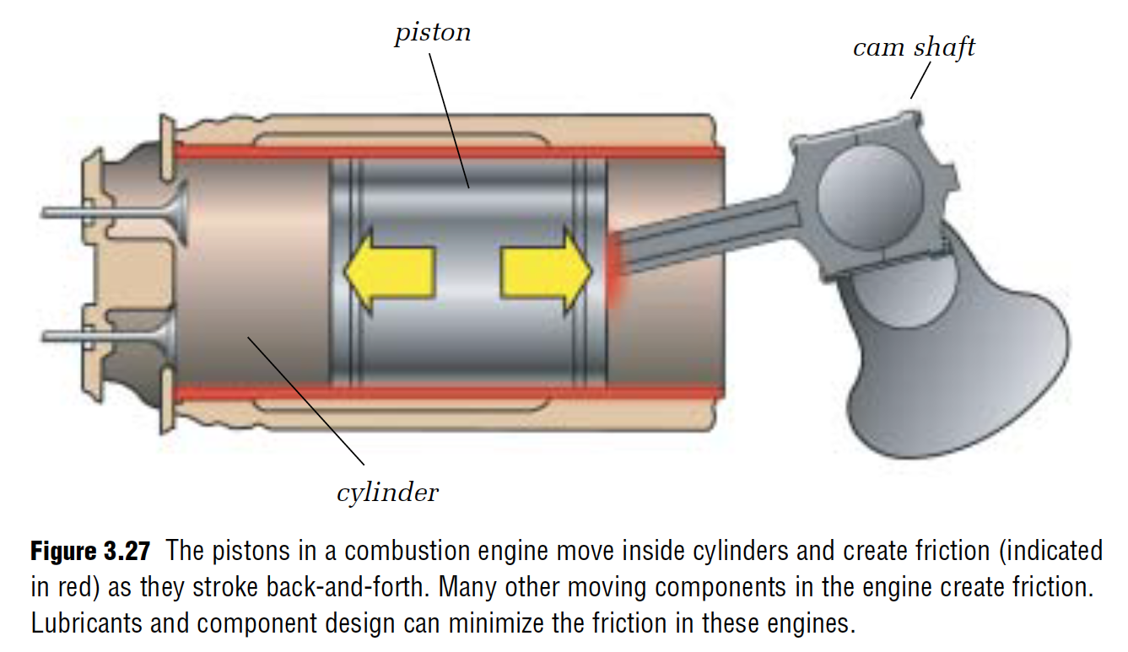
Limits to efficiency!
Tim Craddock – FLVT School

Slide 33
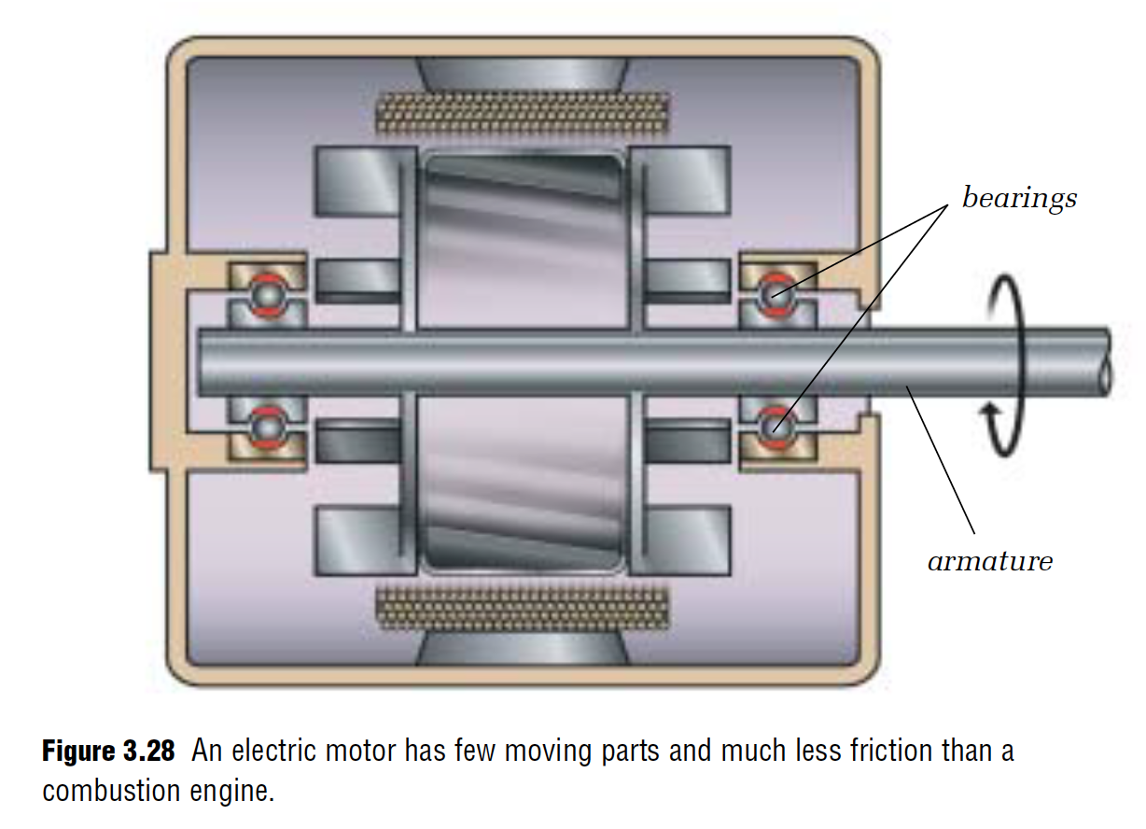
Limits to efficiency!
Tim Craddock – FLVT School

Slide 34
Energuide labels inform us of a products efficiency
Tim Craddock – FLVT School

