Slide 1
Unit D - Electrical Principles & Technologies
Tim Craddock – FLVT School

Slide 2
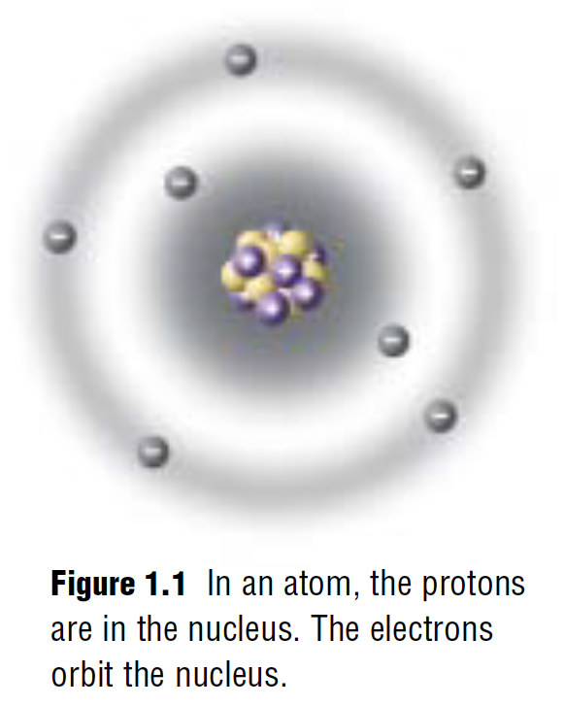
1.1 – Static Electricity
Static charge - refers to charges that are not moving (stationary)
Most objects have equal amounts of positive and negative charge, which makes them neutral.
Negatively charged objects contain more electrons than protons
Positively charged objects contain less electrons than protons
Static charges do not flow like the electrons in current electricity
Recall that:
Protons have a positive charge and are located in the Nucleus
Neutrons do NOT have a charge and are located in the Nucleus
Electrons have a negative charge and are located in the shells around the Nucleus
Tim Craddock – FLVT School

Slide 3
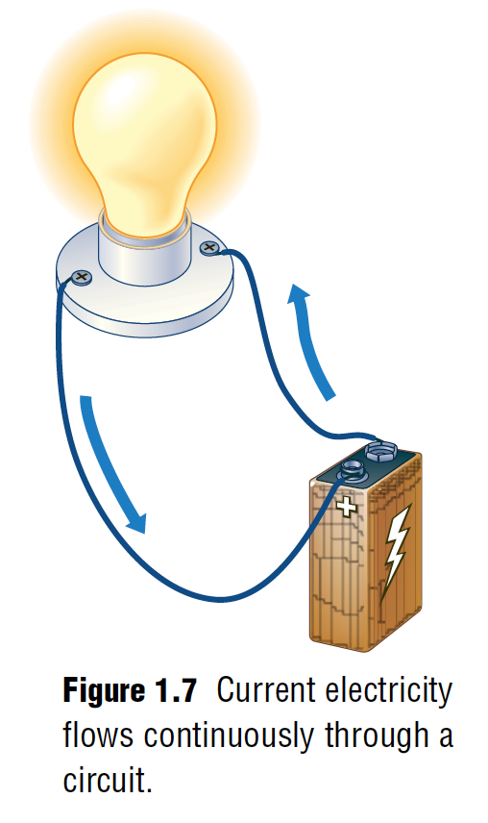
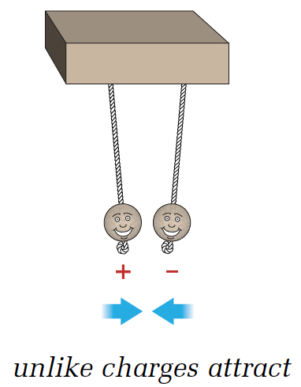
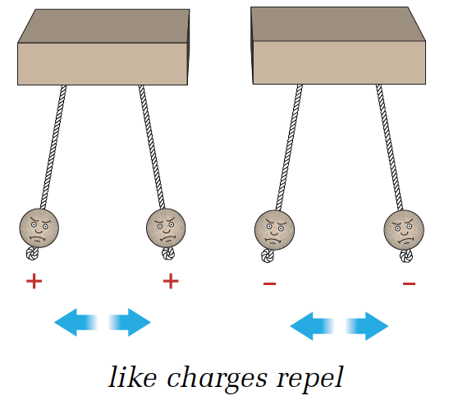
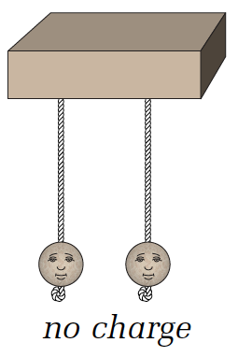
1.1 – Static Electricity
Static Electricity
Current Electricity
NOTE: Charged objects will also ATTRACT objects that are Neutral
Tim Craddock – FLVT School

Slide 4
1.2 – Current Electricity
Static Electricity
Current Electricity
Charges do not flow
Charges can build up and ”jump” from one object to another
Charges flow!!
Electrons travel through conductors.
This is the most used type of electricity as it powers our devices
Tim Craddock – FLVT School

Slide 5
1.2 – Current Electricity
What is Electric Current?
Tim Craddock – FLVT School

Slide 6
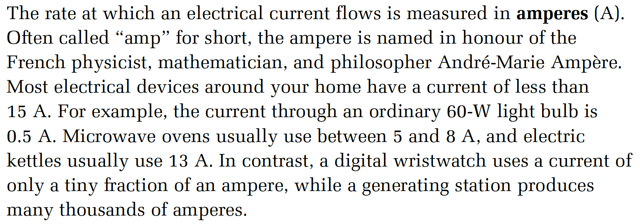
1.2 – Current Electricity
What is Amperage?
Amps are used to measure how much electricity is flowing through a circuit!
Tim Craddock – FLVT School

Slide 7
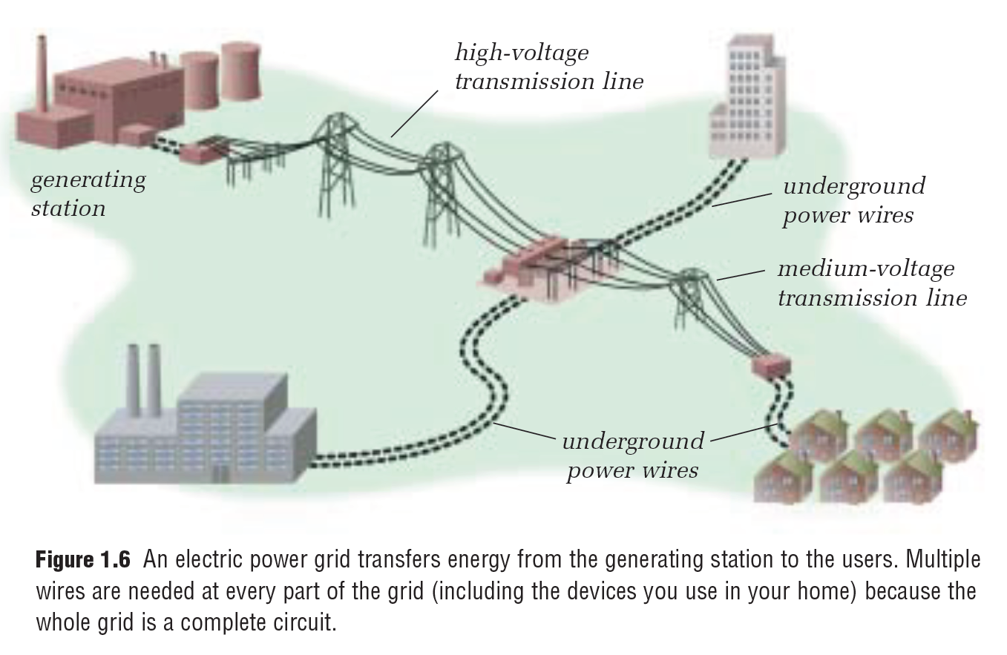
1.2 – Current Electricity
Our electricity is carried to us through giant power lines with an enormous amount of current (amps) and voltage (volts)
Tim Craddock – FLVT School

Slide 8
1.2 – Current Electricity
Circuits
Figure 1.7 shows a light bulb lit by electrical current flowing through a simple circuit. A circuit is a path that controls the flow of electricity. If you compare electricity with water again, the water system in your house is like an electrical circuit. The pipes and taps in the water system control the flow of water.
Tim Craddock – FLVT School

Slide 9
1.2 – Current Electricity
What is a load in a circuit?
In most electrical circuits, the path that the electricity flows along is made of solid metal wires. But circuits can also include gases, other fluids, or other substances. A circuit usually includes a conductor, an energy source, and a load. The load is a device to convert electrical energy to another form of energy. For example, in Figure 1.7, the light bulb is the load. It converts electrical energy to light and heat.
Tim Craddock – FLVT School

Slide 10
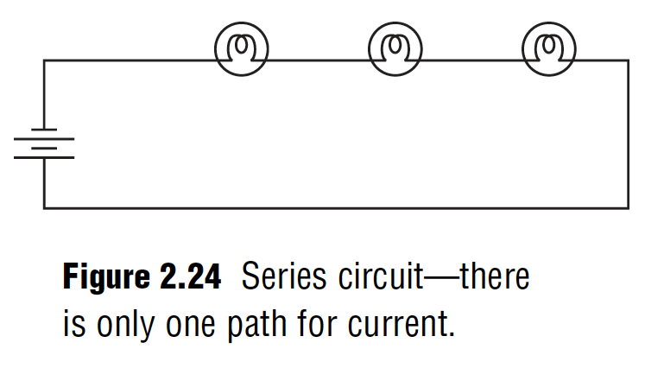
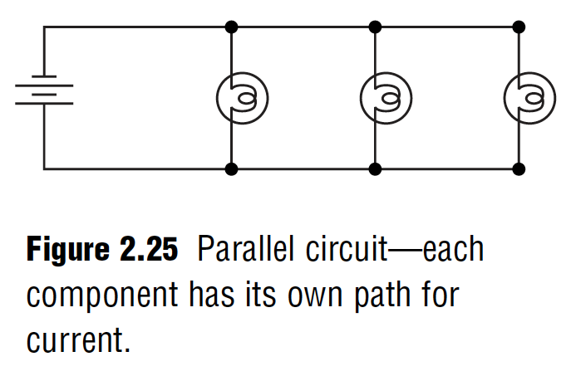
1.2 – Current Electricity
Series Circuit
Parallel Circuit
Connected in 1 big loop
Only 1 pathway
If one load breaks and disrupts the flow, the whole circuit shuts down
As more loads are added to the circuit, the loads receive less power as they all share the energy as all the loads are connected to the same circuit (loop).
Connected in a ”ladder”
Many pathways
If one load breaks down, the other loads will not be affected unless they are connected to the same loop in the circuit.
As more loads are added, the other loads are not affected.
Tim Craddock – FLVT School

Slide 11
1.2 – Current Electricity
What is Voltage?
Volts are used to measure how much electricity is available to the circuit!
Tim Craddock – FLVT School

Slide 12
1.2 – Current Electricity
How can we measure the voltage in a circuit?
Multimeters like the one pictured to the left can be used to various things like volts, millivolts, amps, milliamps, ohms, etc. and they tend to be less expensive
Tim Craddock – FLVT School

Slide 13
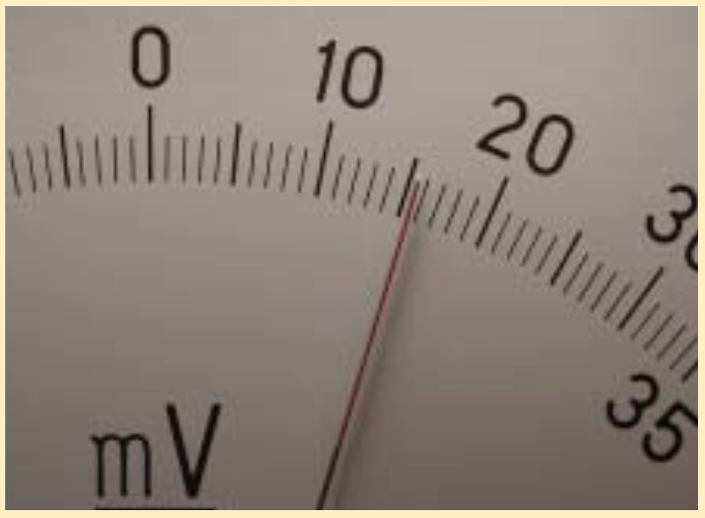
1.2 – Current Electricity
What is the voltage reading?
What is the voltage reading in the picture in:
mV (millivolts)
V (volts)
kV (kilovolts)
Tim Craddock – FLVT School

Slide 14
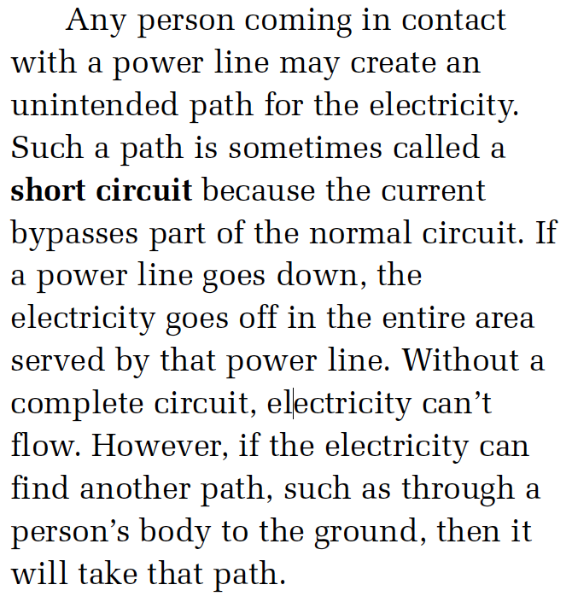
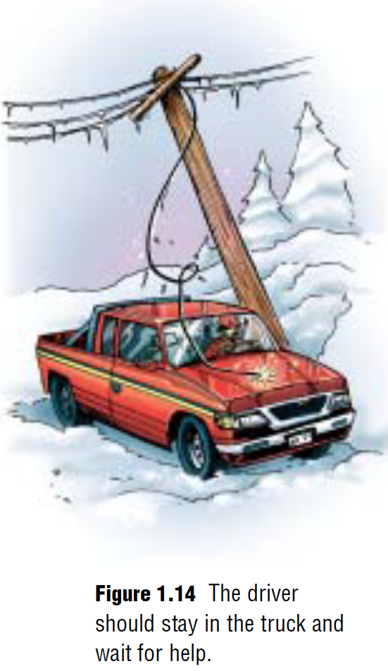
1.3 – Electrical Safety
Short Circuits
Tim Craddock – FLVT School

Slide 15
1.3 – Electrical Safety
Factors Affecting Electrical Shock
Tim Craddock – FLVT School

Slide 16
1.2 – Current Electricity
Protecting Ourselves from
Electrical Shock
Fuses
Circuit Breakers
NOT reusable
Contains a metal strip that melts when a circuit is overloaded. Once the strip melts, the circuit shuts down as the flow of electricity is now stopped.
Reusable
Contains a bimetallic strip that bends when a circuit is overloaded. Once the strip bends far enough to fall into a tiny notch, the circuit shuts down as the flow of electricity is now stopped.
Tim Craddock – FLVT School

Slide 17
1.3 – Electrical Safety
Lightning Rods
Tim Craddock – FLVT School

Slide 18
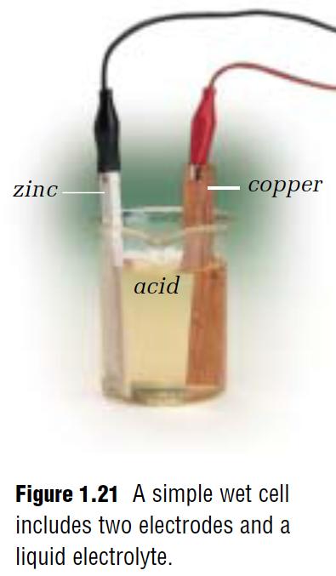
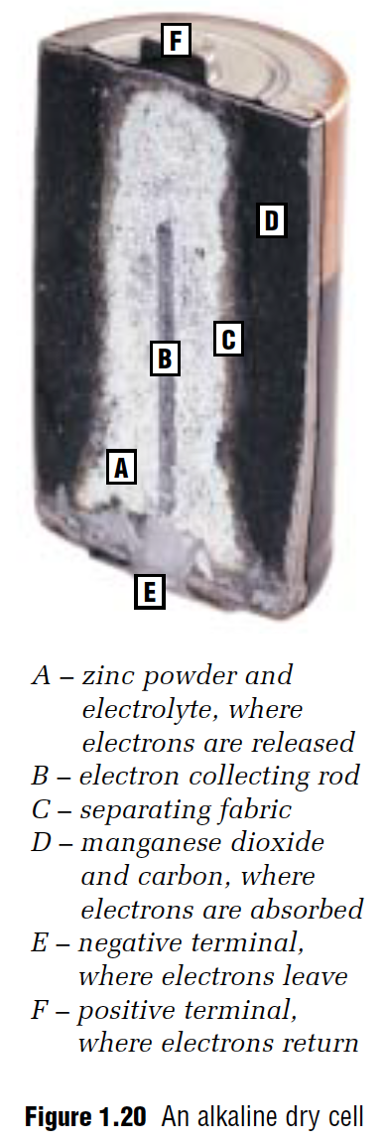
1.4 – Cells and Batteries (Electrochemical Cell)
THE PARTS OF AN ELECTROCHEMICAL CELL ARE:
1 Electrolyte
2 Different Electrodes
Tim Craddock – FLVT School

Slide 19
1.4 – Cells and Batteries (Electrochemical Cell)
Dry Cells
Wet Cells
The electrolyte in the battery is made up of a chemical PASTE
The electrolyte in the battery is made up of a chemical LIQUID
Primary Cells
Secondary Cells
Cells that are only used once and then disposed of at a household hazardous waste collection site
Cells that can be recharged and used more than once. These cells are capable of having the flow of electrons reversed so they can essentially be filled up with electrons over and over.
Tim Craddock – FLVT School

Slide 20
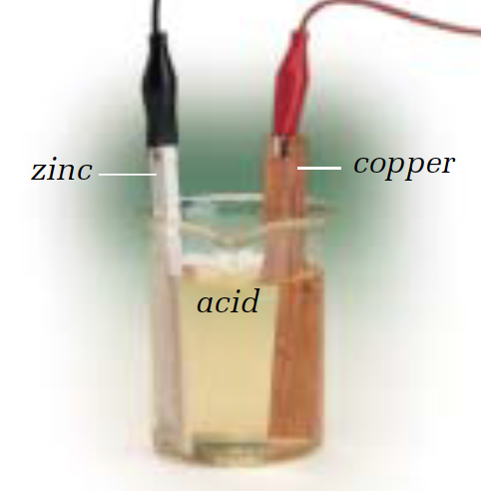
1.4 – Cells and Batteries (Electrochemical Cell)
Dry Primary Cell
Wet Primary Cell
Dry Secondary Cell
Wet Secondary Cell
Tim Craddock – FLVT School

Slide 21
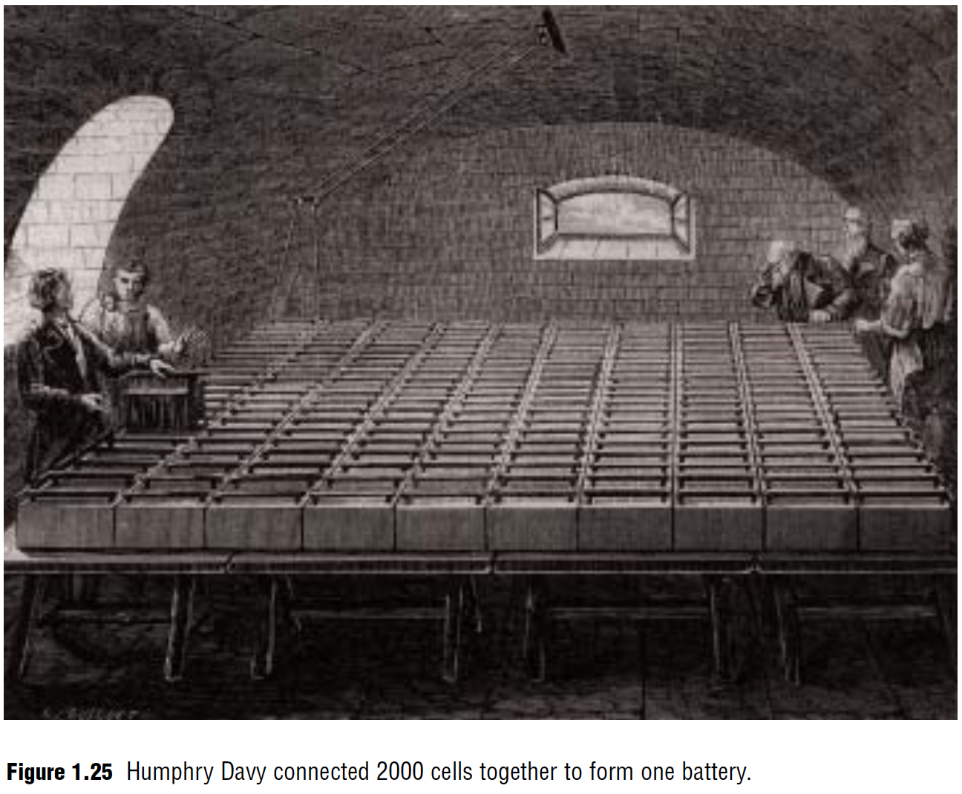
1.4 – Cells and Batteries
Electrochemistry
Tim Craddock – FLVT School

Slide 22
1.4 – Cells and Batteries
Electrolysis
Tim Craddock – FLVT School

Slide 23
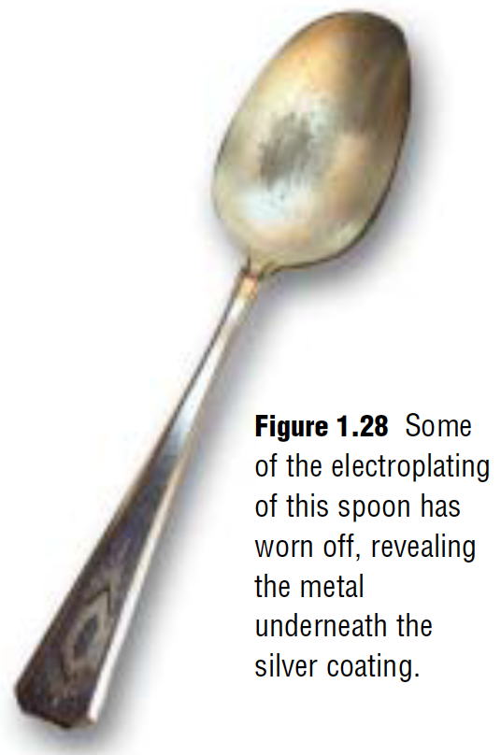
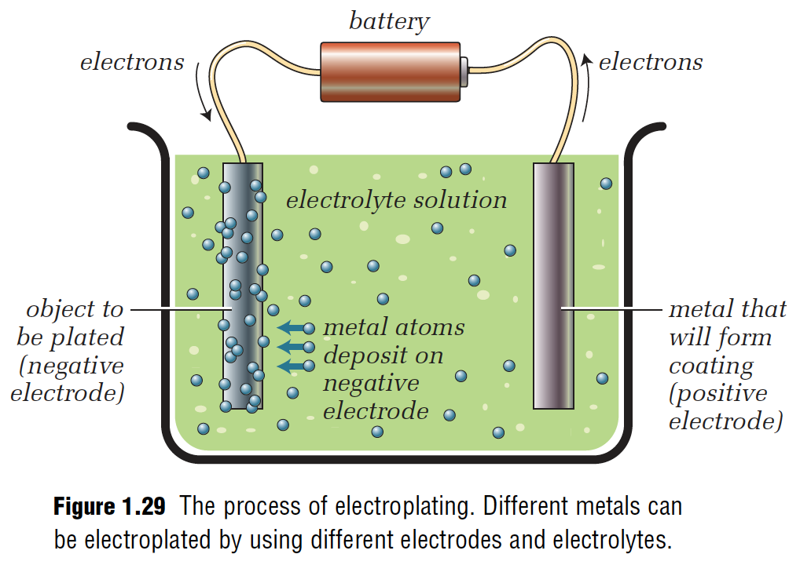
1.4 – Cells and Batteries
Electroplating
Tim Craddock – FLVT School

Slide 24
1.4 – Cells and Batteries
Anodizing
Tim Craddock – FLVT School

Slide 25
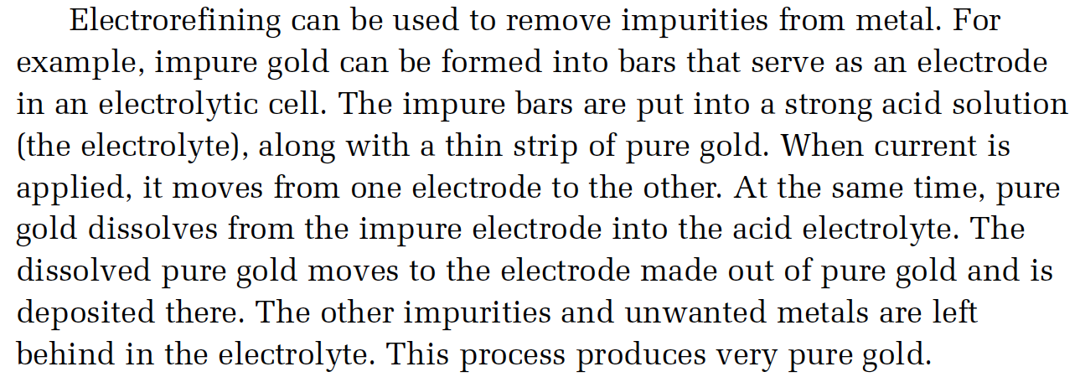
1.4 – Cells and Batteries
Electrorefining
Tim Craddock – FLVT School

